Slide 1
Edibles
Aashish Thota
Sri Venkat Sumanth Sanakkayala
Nikhil Shravan Krishna Sanka
Sai Teja

Slide 2

Motivation
Living away from home there are many challenges we have to face. Out of them many feel cooking as an major task. The food items are recognized with different names in different places which creates a confusion for a person who is new at cooking and some does not know the names of the food items/ vegetables. Eventually they end up searching for a the items names online. And next subtask is to decide which Item to cook with the items left with them. We did not find any solution to this problem yet. So this Task motivated us to create a solution.

Slide 3

Objective
This application Scans the vegetables and gives the name of the vegetable as output
The user can add the scanned item to the list. Or the user can also manually type in the name of the vegetable or ingredient if he knows about that and add it to the list.
The application provides the user with list of recipes with the added ingredient list
The user can select any recipe from the list and then view the ingredients and instructions to cook that recipe.
The User can also Upload his own recipe.

Slide 4


Simple Architecture

Slide 5
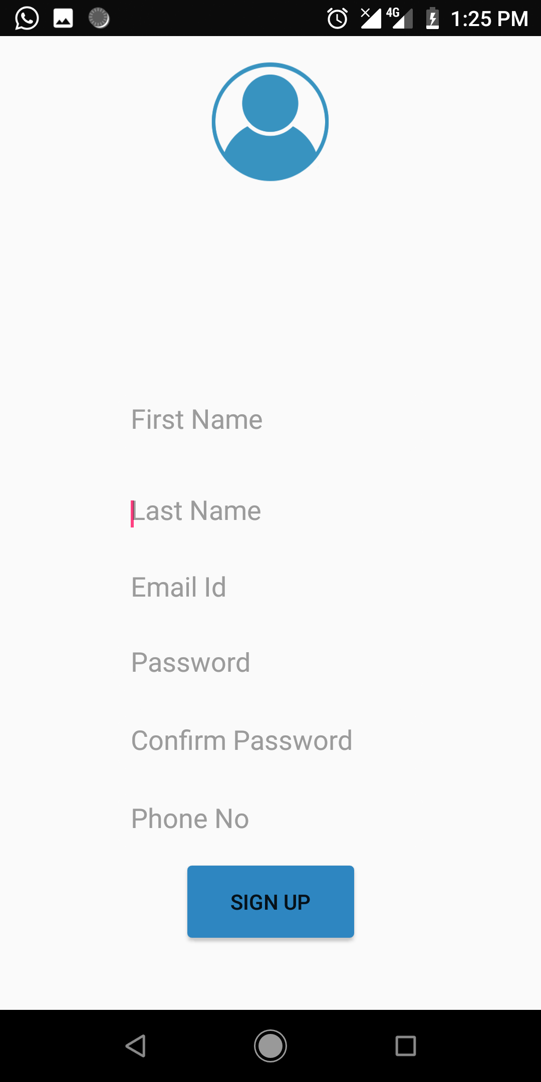
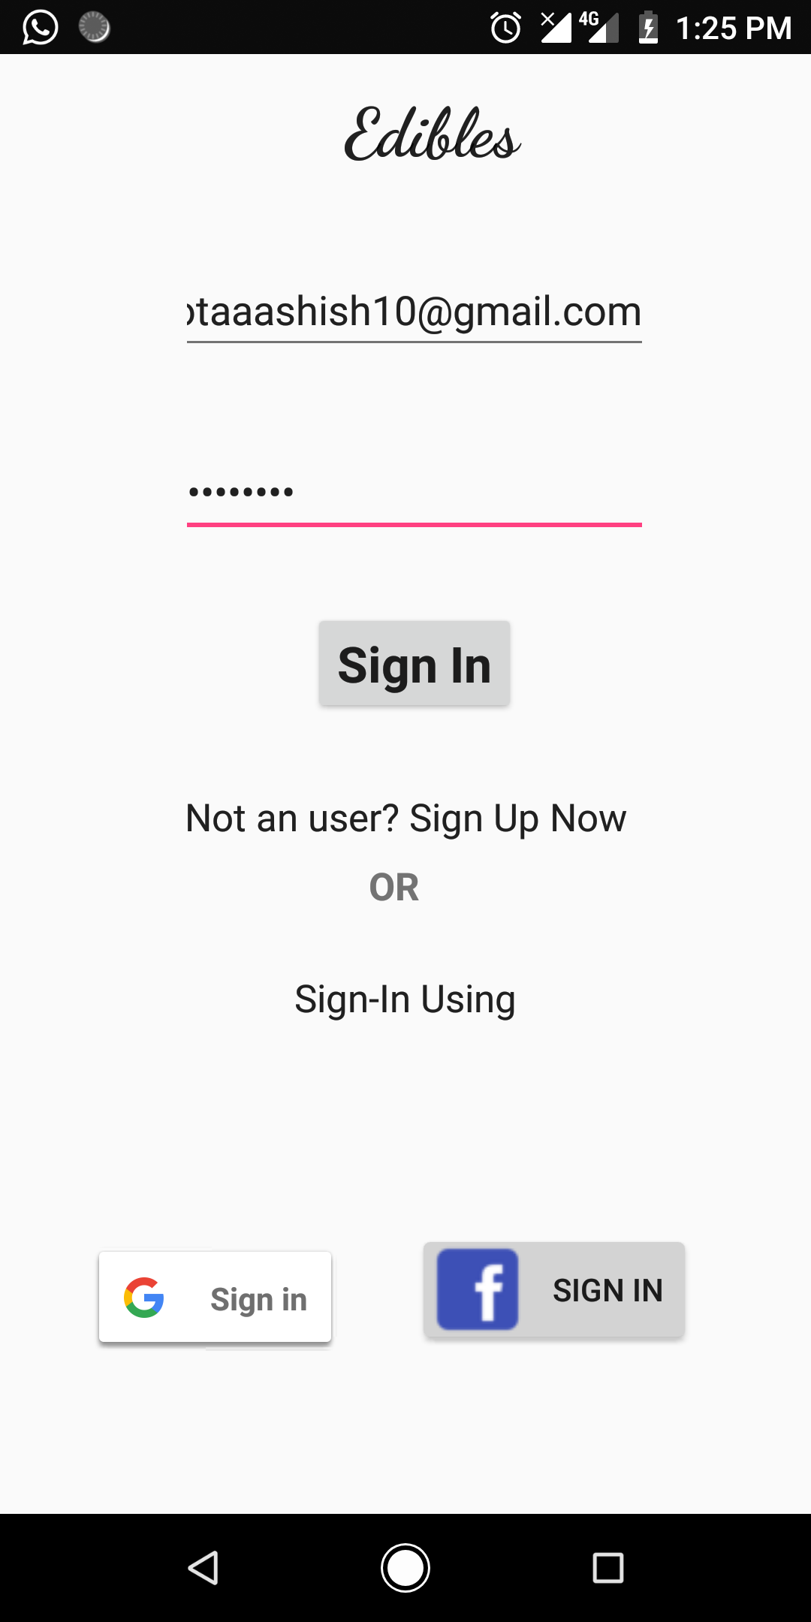
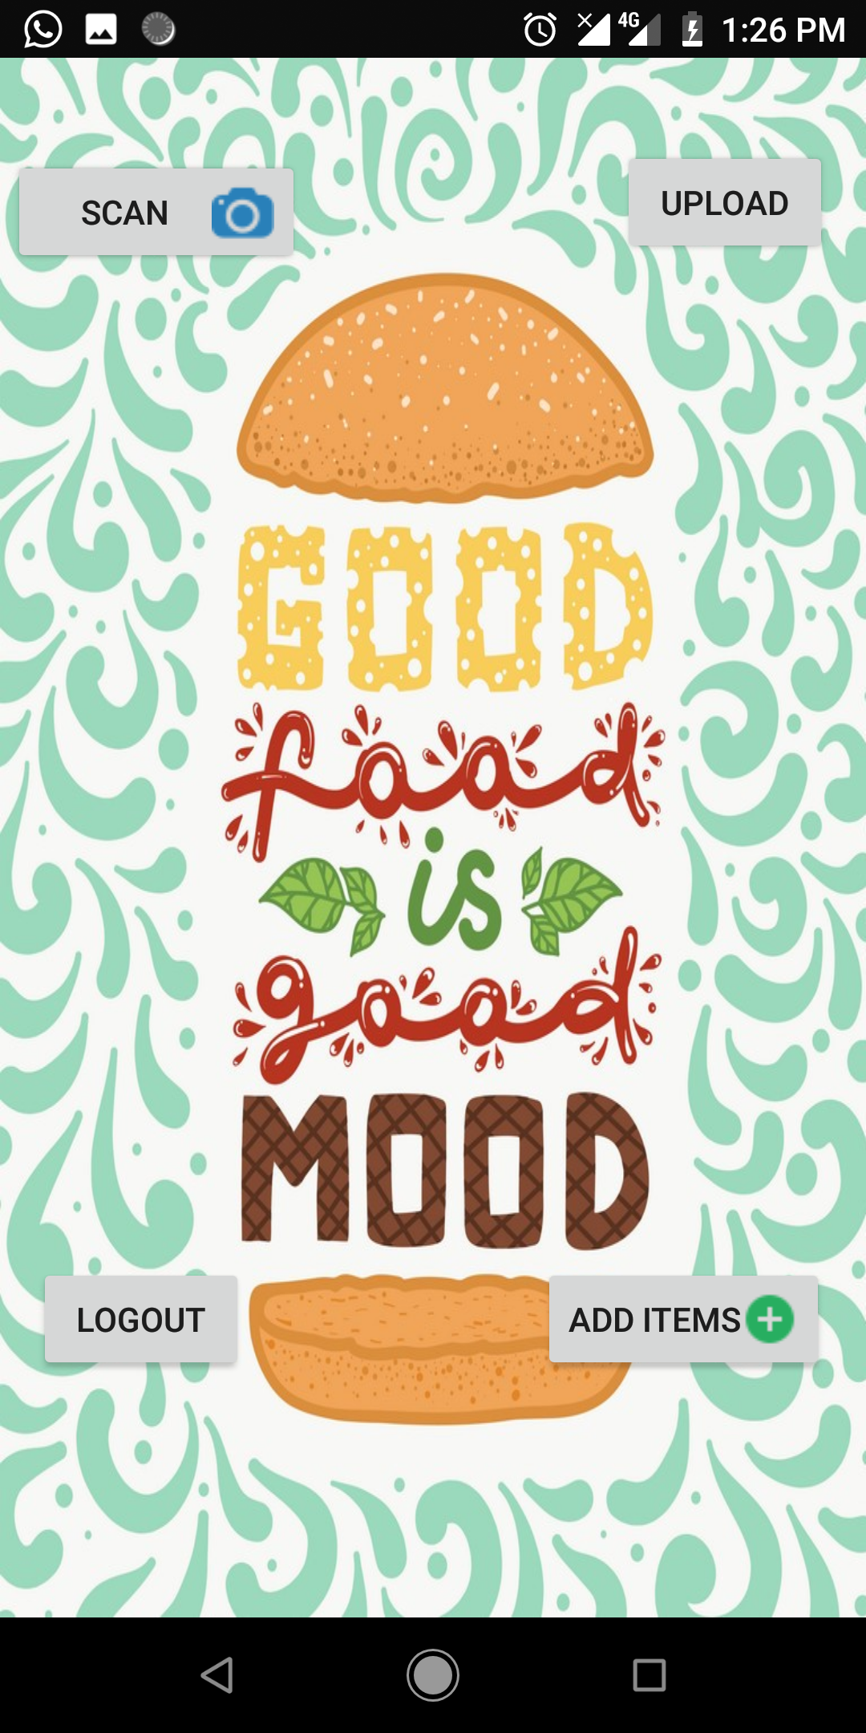

Slide 6
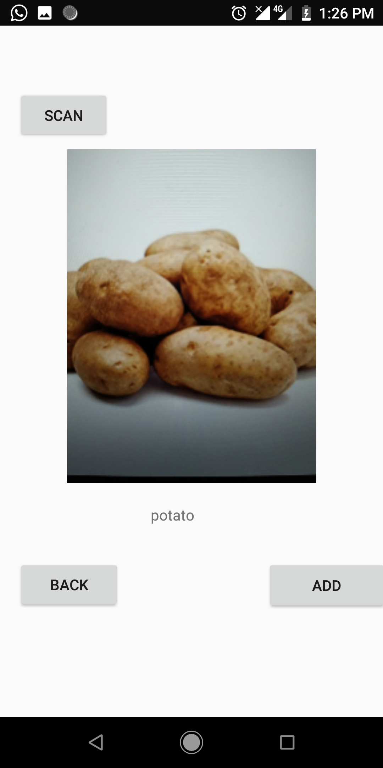
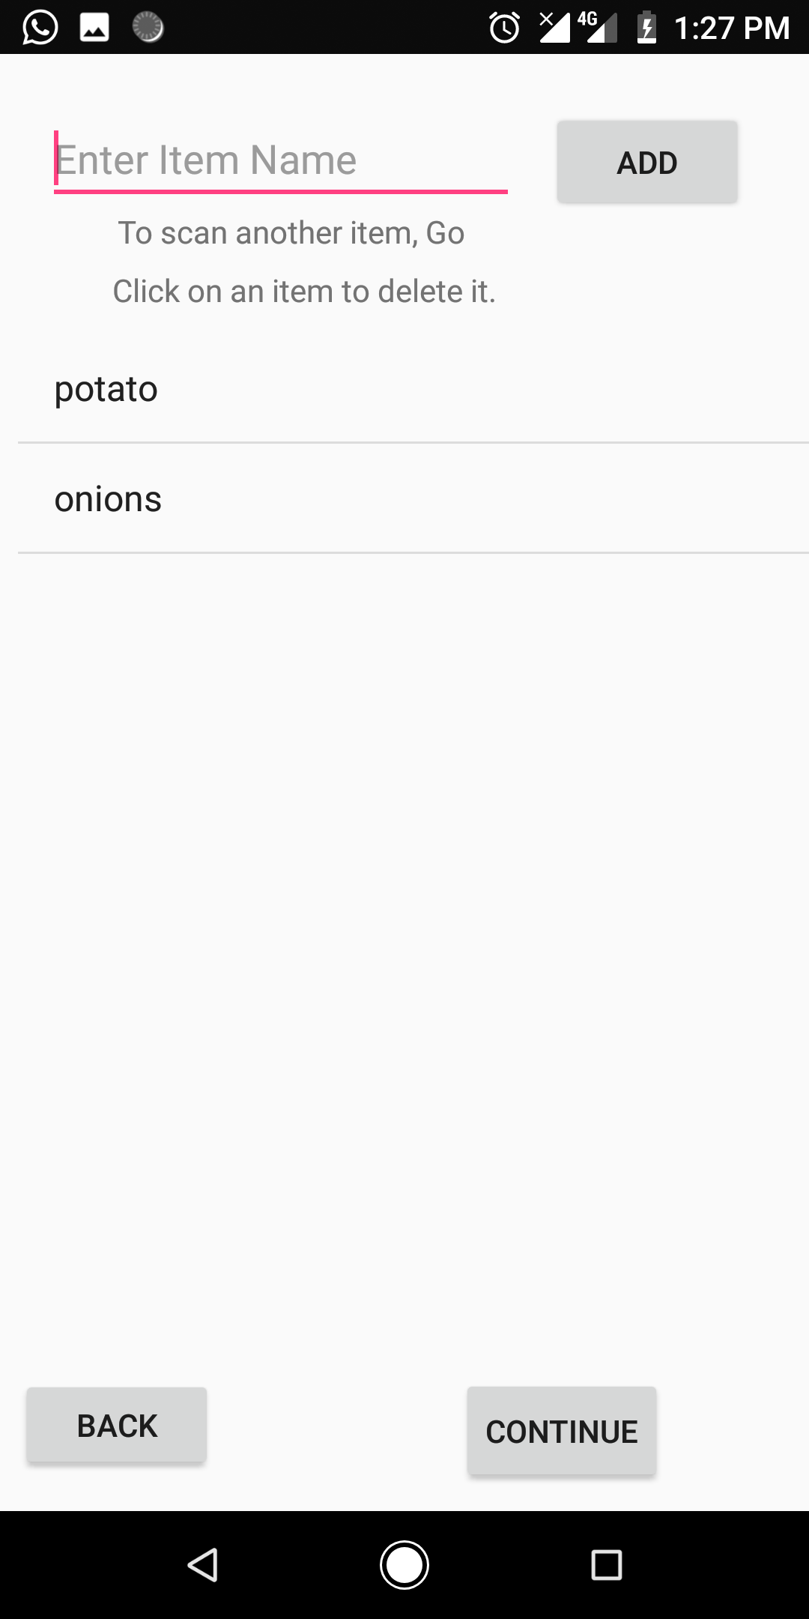
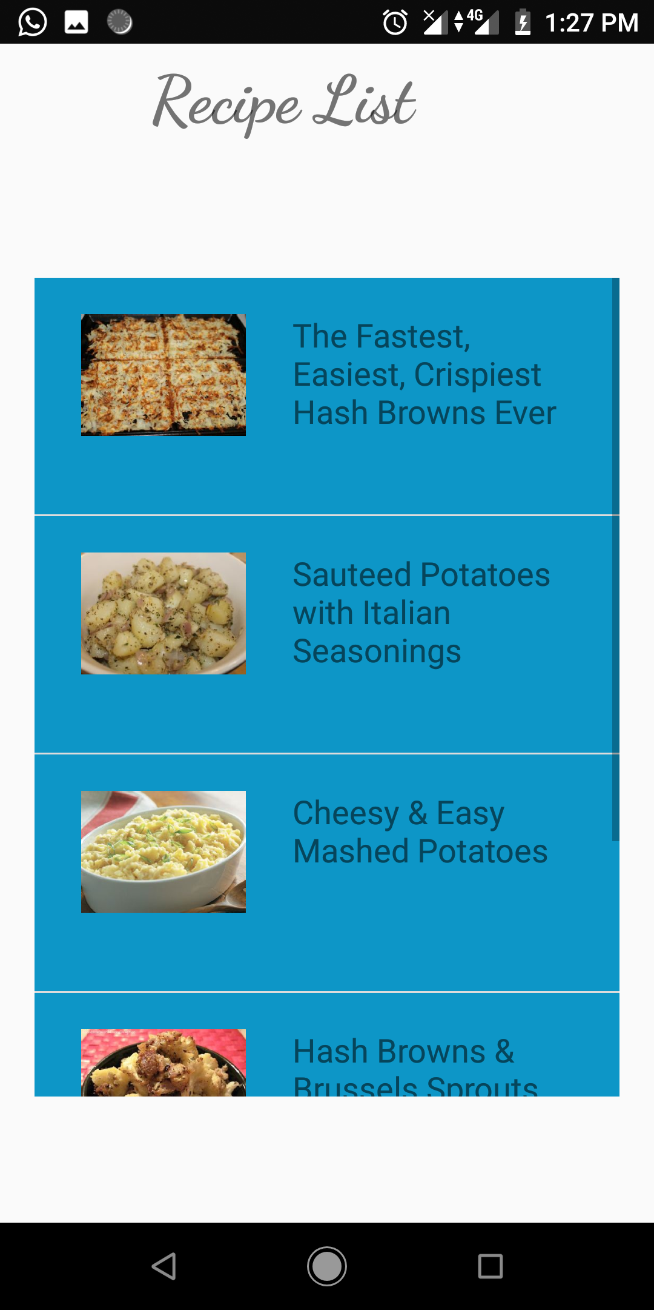

Slide 7
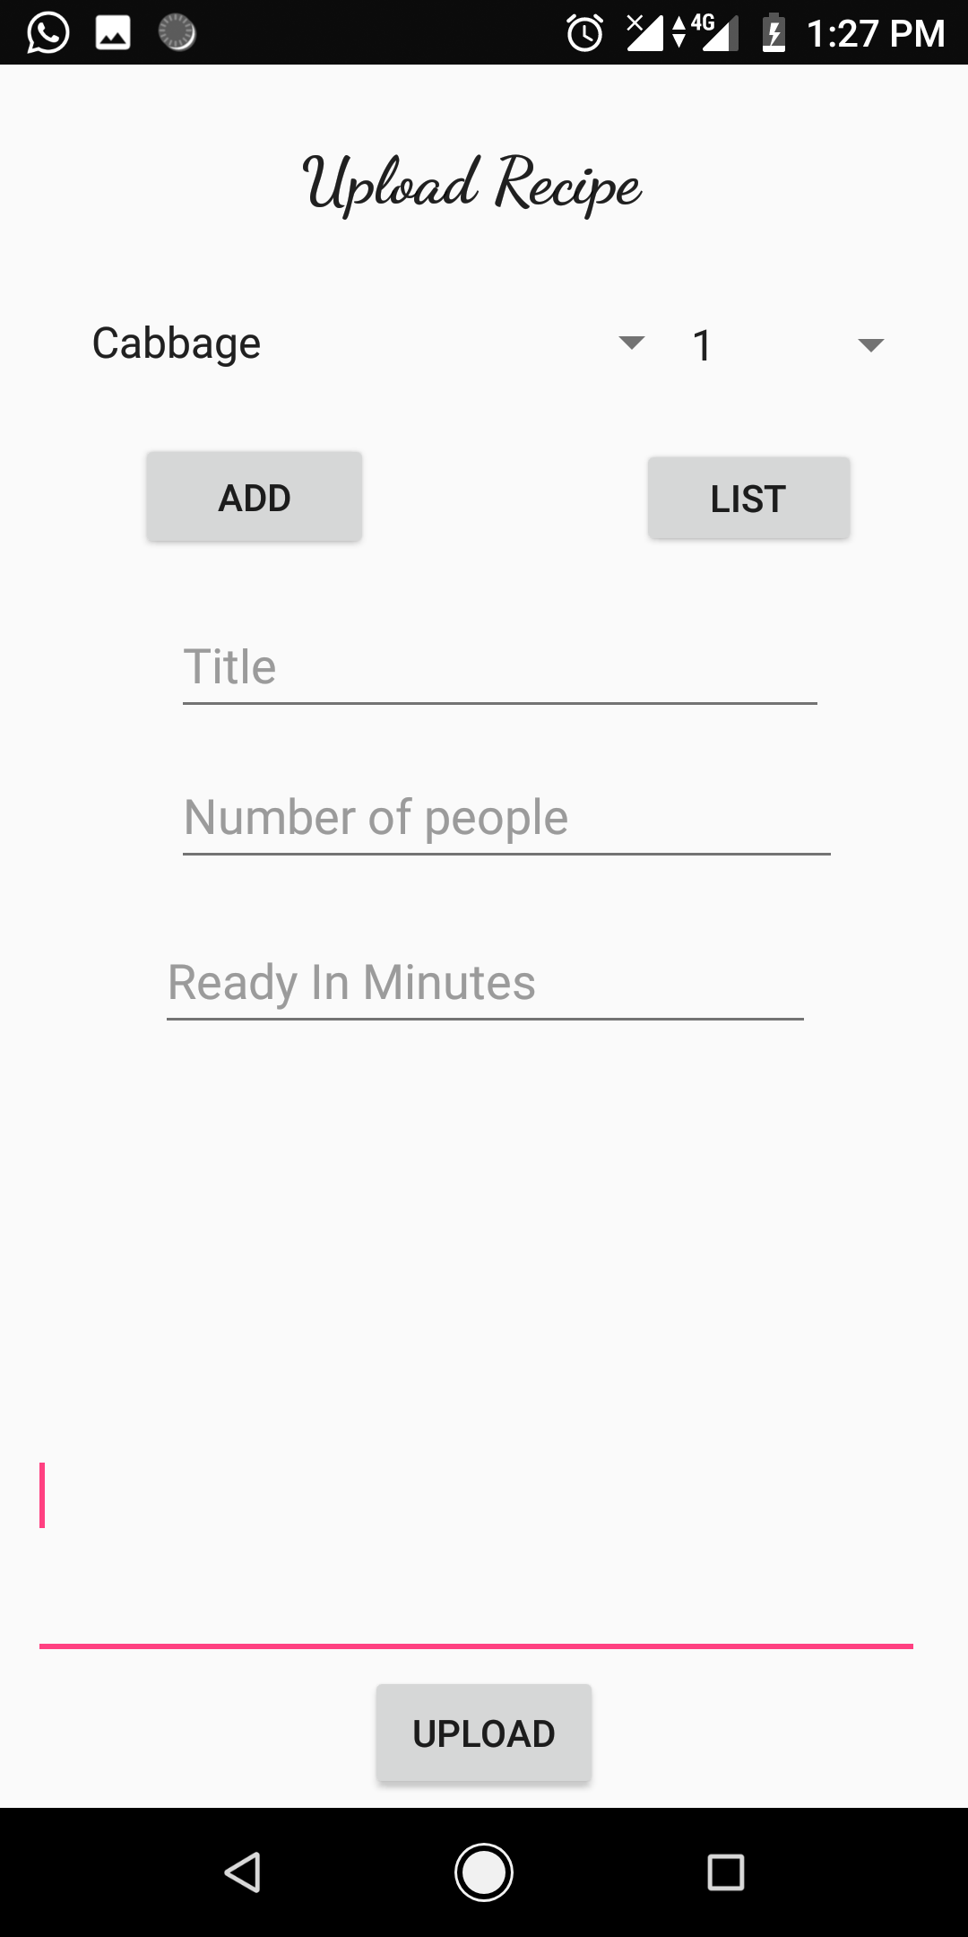

Slide 8
API’S USED
IBM Visual Recognition API
Recipe-Food-Nutrition API

Slide 9
Future Scope
The application should be able to scan multiple items at a time.
We can embed weekly planner so that the application can also work as a grocery maintenance system.

Slide 10
Thank You

